Slide 1
Module - 2(Filled Area Primitives and transformations)
Filled Area Primitives- Scan line polygon filling, Boundary filling and flood filling. Two dimensional transformations-Translation, Rotation, Scaling, Reflection and Shearing, Composite transformations, Matrix representations and homogeneous coordinates. Basic 3D transformations.

Slide 2
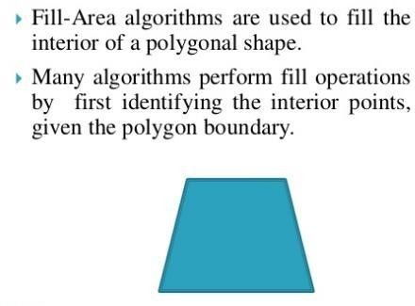
AREA FILLING OR POLYGON FILLING ALGORITHMS
Boundary fill algorithm
Flood fill algorithm
Scan line filling algorithm
2

Slide 3
BOUNDARY FILL ALGORITHM
Boundary Fill Algorithm starts at a pixel inside the polygon to be filled and paints the interior proceeding outwards towards the boundary.
This algorithm works only if the color with which the region has to be filled and the color of the boundary of the region are different.
If the boundary is of one single color, this approach proceeds outwards pixel by pixel until it hits the boundary of the region.
3

Slide 4
It takes an interior point(x, y), a fill color, and a boundary color as the input.
The algorithm starts by checking the color of (x, y).
If it’s color is not equal to the fill color and the boundary color, then it is painted with the fill color and the function is called for all the neighbours of (x, y).
If a point is found to be of fill color or of boundary color, the function does not call its neighbours and returns.
This process continues until all points up to the boundary color for the region have been tested.
The boundary fill algorithm can be implemented by 4- connected pixels or 8-connected pixels.
9/21/2020
4

Slide 5
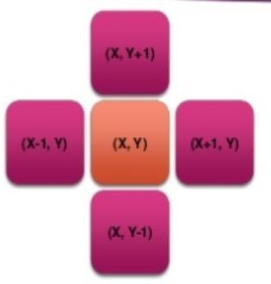
4-connected pixels
After painting a pixel, the function is called for four neighboring points.
These are the pixel positions that are right, left, above and below the current pixel.
Areas filled by this method are called 4-connected
9/21/2020
5

Slide 6
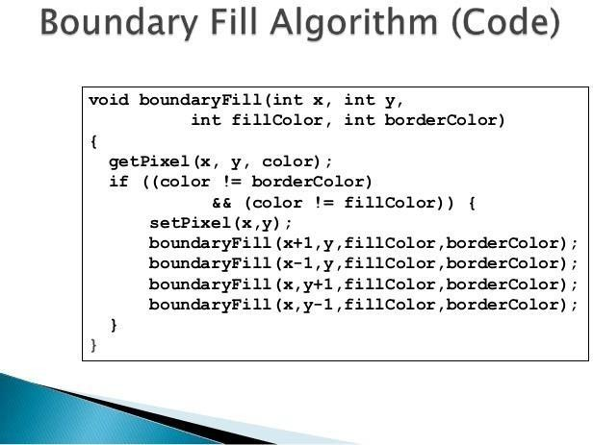
9/21/2020
6

Slide 7
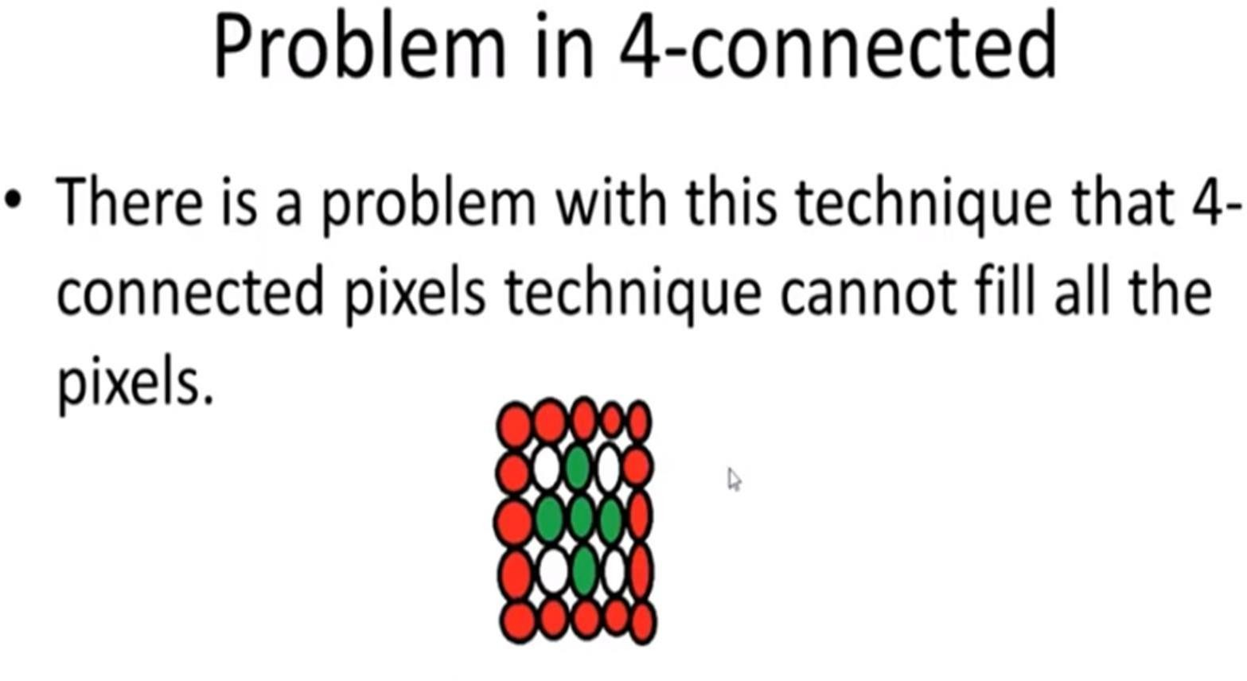
9/21/2020
7

Slide 8
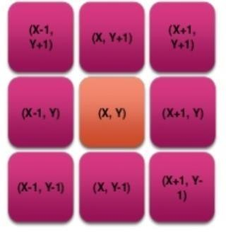
8-connected pixels
More complex figures are filled using this approach.
The pixels to be tested are the 8 neighboring pixels, the pixel on the right, left, above, below and the 4 diagonal pixels.
Areas filled by this method are called 8-connected.
9/21/2020
MAHAGURU INSTITUTE OF TECHNOLOGY
8

Slide 9
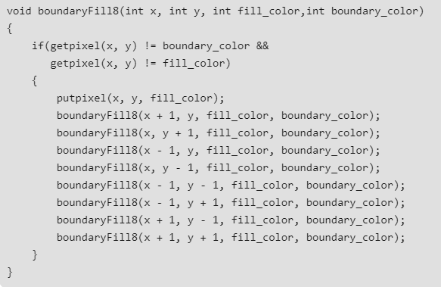
9/21/2020
MAHAGURU INSTITUTE OF TECHNOLOGY
9

Slide 10
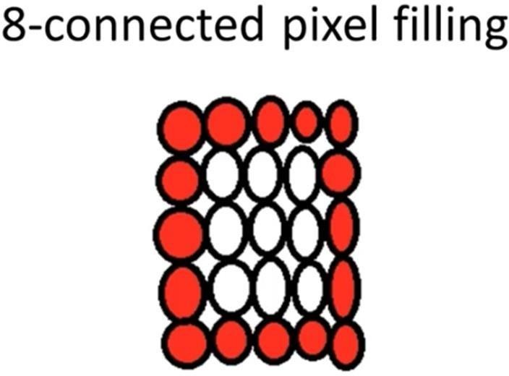
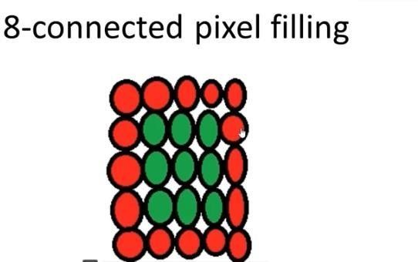
9/21/2020
10

Slide 11
Algorithm
In this method, a point or seed which is inside region is selected.
This point is called a seed point.
Then four connected approaches or eight connected approaches is used to fill with specified color.
This method is more suitable for filling multiple colors boundary.
When boundary is of many colors and interior is to be filled with one color we use this algorithm.
In fill algorithm, we start from a specified interior point (x, y) and reassign all pixel values are currently set to a given interior color with the desired color.
Using either a 4-connected or 8-connected approaches, we then step through pixel positions until all interior points have been repainted.

Slide 12
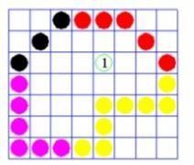
9/21/2020

Slide 13
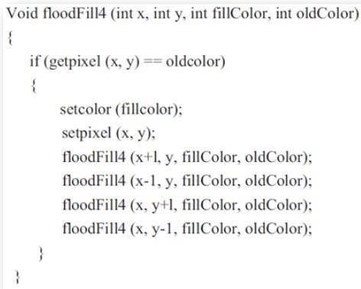
9/21/2020

Slide 14
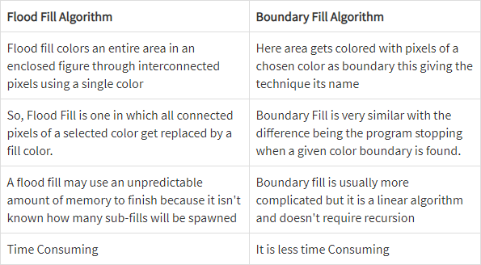
9/21/2020

Slide 15
SCAN LINE POLYGON FILLING ALGORITHM
For each scan line crossing a polygon, the area-fill algorithm locates the intersection points of the scan line with the polygon edges.
These intersection points are then sorted from left to right,
And the corresponding frame-buffer positions between each intersection pair are set to the specified fill color.
In the example the four pixel intersection positions with the polygon boundaries define two stretches of interior pixels from x = 10 to x = 14 and from x = 18 to x = 24

Slide 16
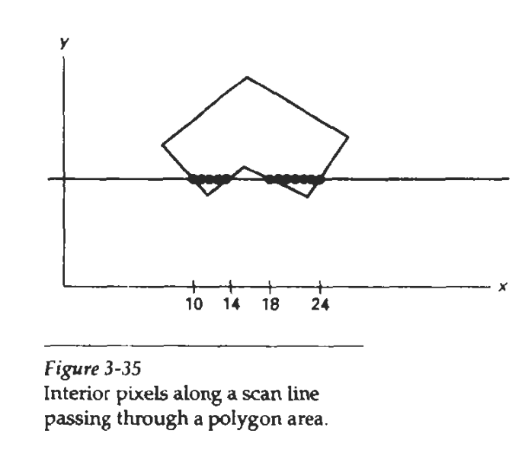

Slide 17
Some scan-line intersections at polygon vertices require special handling.
A scan line passing through a vertex intersects two edges at that position, adding two points to the list of intersections for the scan line.
Figure 3-36 shows two scan lines at positions y and y' that intersect edge endpoints.
Scan line y intersects five polygon edges.
Scan line y’, however, intersects an even number of edges although it also passes through a vertex.
Intersection points along scan line y' correctly identify the interior pixel spans.
But with scan line y, we need to do some additional processing to determine the correct interior points

Slide 18
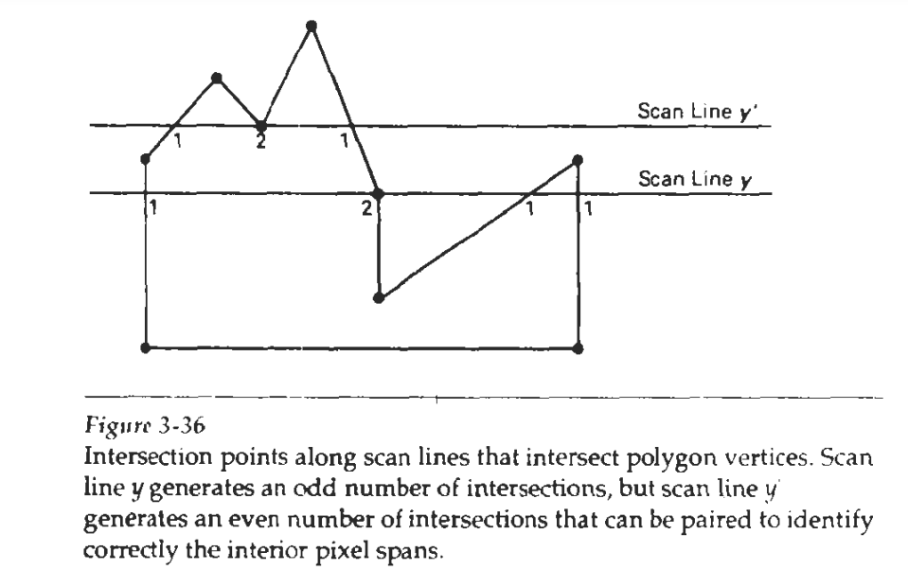

Slide 19
For scan line y, the two intersecting edges sharing a vertex are on opposite sides of the scan line
Thus, the vertices that require additional processing are those that have connecting edges on opposite sides of the scan line.
But for scan line y', the two intersecting edges are both above the scan line.

Slide 20
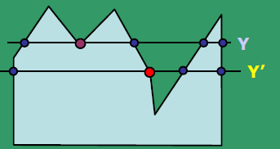
Special cases of polygon
If both lines intersecting at the vertex are on the same side of the scan line, consider it as two points.
If lines intersecting at the vertex are at opposite sides of the scan line, consider it as only one point.
For Y, the edges at the vertex are on the same side of the scan line.
Whereas for Y’, the edges are on either/both sides of the vertex.
In this case, we require additional processing.
9/21/2020

Slide 21
To identify the vertices are :
Traverse along the polygon boundary clockwise (or counter- clockwise) and Observe the relative change in Y-value of the edges on either side of the vertex (i.e. as we move from one edge to another).
Check the condition:
If end-point Y values of two consecutive edges monotonically increase or decrease, count the middle vertex as a single intersection point for the scan line passing through it.
Otherwise, the shared vertex represents a local extremum (minimum or maximum) on the polygon boundary,
and the two edge intersections with the scan line passing through that vertex can be added to the intersection list.
9/21/2020

Slide 22
For counting a vertex as one intersection, shorten some polygon edge to split those vertices that should be counted as one intersection.
process nonhorizontal edges around the polygon boundary in the order specified, either clockwise or counterclockwise.
As we process each edge, we can check to determine whether that edge and the next nonhorizontal edge have either monotonically increasing or decreasing endpoint y values.
If so, the lower edge can be shortened to ensure that only one intersection point is generated for the scan line going through the common vertex joining the two edges.

Slide 23
Figure 3-37 illustrates shortening of an edge.
When the endpoint y coordinates of the two edges are increasing, the y value of the upper endpoint for the current edge 1s decreased by 1, as in Fig. 3-37(a).
When the endpoint y values are monotonically decreasing, as in Fig. 3-37(b),
we decrease they coordinate of the upper endpoint of the edge following the current edge.

Slide 24
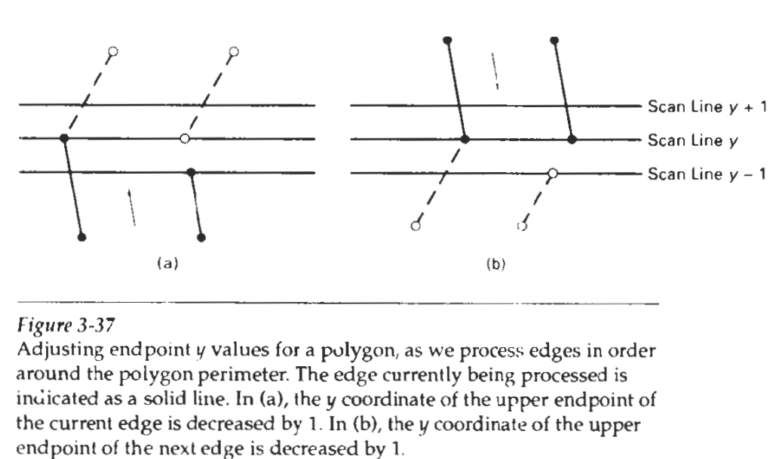

Slide 25
Calculations performed in scan-conversion and other graphics algorithms typically take advantage of various coherence properties of a scene that is to be displayed.
coherence is simply that the properties of one part of a scene are related in some way to other parts of the scene so that the relationship can be used to reduce processing.
Coherence methods often involve incremental calculations applied along a single scan line or between successive scan lines.
In determining edge intersections, we can set up incremental coordinate calculations along any edge by exploiting the fact that the slope of the edge is constant from one scan line to the next.

Slide 26
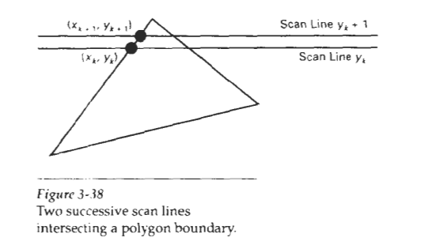
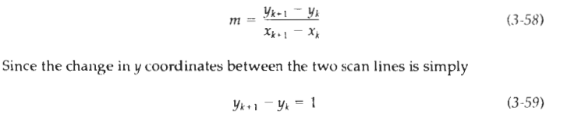

The slope of this polygon boundary line can be expressed in terms of the scan-line intersection coordinates:
the x-intersection value xi,, on the upper scan line can be determined from the x-intersection value xk on the preceding scan line as
Each successive x intercept can thus be calculated by adding the inverse of the slope and rounding to the nearest integer

Slide 27


IMPLEMENTATION OF INTEGER OPERATION
In a sequential fill algorithm, the increment of x values by the amount l/m along an edge can be accomplished with integer operations by recalling that thc slope m is the ratio of two integers:
where dx and dy are the differences between the edge endpoint x and y coordinate values. Thus, incremental calculations of x intercepts along an edge for successive scan lines can be expressed as

Slide 28
Using this equation we can perform integer evaluation of the x intercepts by initializing a counter to 0,
Then incrementing the counter by the value of dx each time we move up to a new scan line.
Whenever the counter value becomes equal to or greater than dy,
we increment the current x intersection value by 1 and decrease the counter by the value dy.
This procedure is equivalent to maintaining integer and fractional parts for x intercepts and incrementing the fractional part until we reach the next integer value.

Slide 29
As an example of integer incrementing, suppose we have an edge with slope rn = 7/3.
dx =3,dy=7
At the initial scan line, we set the counter to 0 and the counter increment to 3.
As we move up to the next three scan lines along this edge, the counter is successively assigned the values 3, 6, and 9

Slide 30
3
Scan line | Counter | (x,y) | Description
0 | 0 | 1,1 | Initial points
1 | 0+3=3 | 1,2 | Counter<dy thus x same y =y+1
2 | 3+3=6 | 1,3 | Counter<dy thus x same y =y+1
3 | 6+3=9 | 2,4 | Counter>dy thus x=x+1,y=y+1, counter=9-7=2
4 | 2 | 2,5 | Counter<dy thus x same y =y+1

Slide 31
We can round to the nearest pixel x-intersection value, instead of truncating to obtain integer positions, by modifying the edge-intersection algorithm so that the increment is compared to dy/2
Initialize the counter to 0
incrementing the counter with the value 2dx
at each step and comparing the increment to dy
When the increment is greater than or equal to dy, we increase the x value by 1 and decrement the counter by the value of 2dy.

Slide 32
Scan line | Counter | (x,y) | Description
0 | 0 | 1,1 | Initial points
1 | 0+6=6 | 1,2 | Counter<dy thus x same y =y+1
2 | 6+6=12 | 2,3 | Counter>dy so x and y increases Counter=12-14=-2
3 | -2+6=4 | 2,4 | Counter<dy thus x same y =y+1
4 | 4+6=10 | 2,5 | Counter>dy so x and y increases Counter=10-14=-4

Slide 33
To efficiently perform a polygon fill, first store the polygon boundary in a sorted edge table that contains all the information necessary to process the scan lines efficiently.
Only nonhorizontal edges are entered into the sorted edge table. As the edges are processed, also shorten certain edges to resolve the vertex intersection question.
Each entry in the table for a particular scan line contains maximum y value for that edge, the x-intercept value (at the lower vertex) for the edge, and the inverse slope of the edge.
For each scan line, the edges are in sorted order from left to nght.
Figure 3-39 shows a polygon and the associated sorted edge table

Slide 34
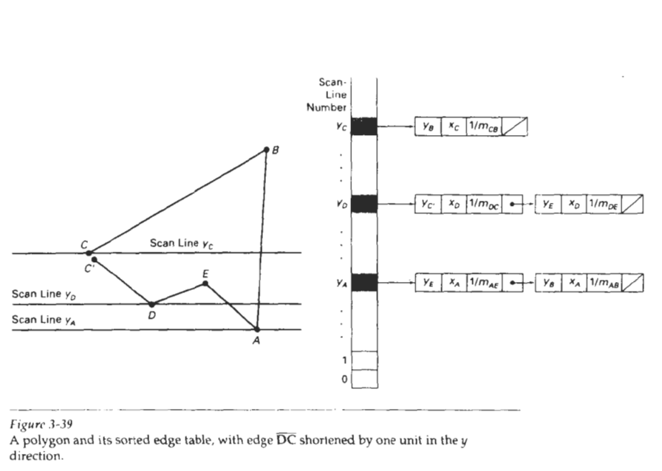

Slide 35
Next, we process the scan lines from the bottom of the polygon to its top, Producing an active edge list for each scan line crossing the polygon boundaries.
The active edge list for a scan line contains all edges crossed by that scan line, with iterative coherence calculations used to obtain the edge intersections

Slide 36
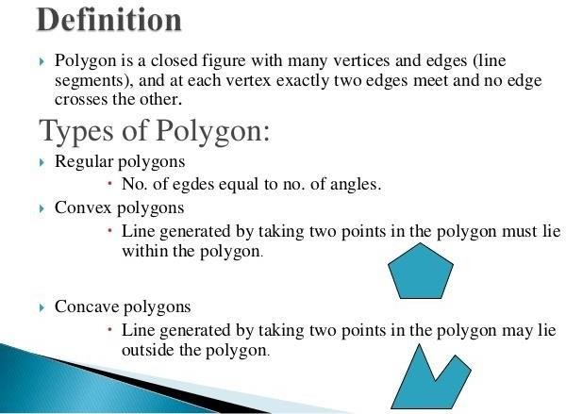
9/21/2020

Slide 37
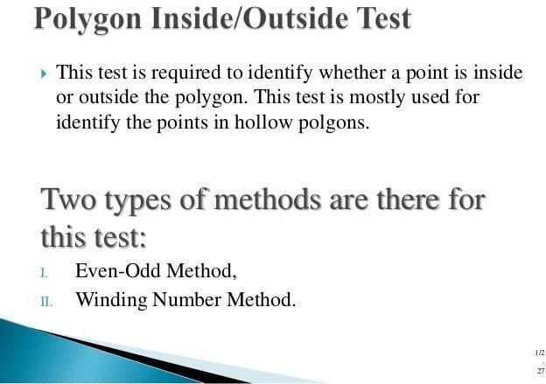
9/21/2020

Slide 38
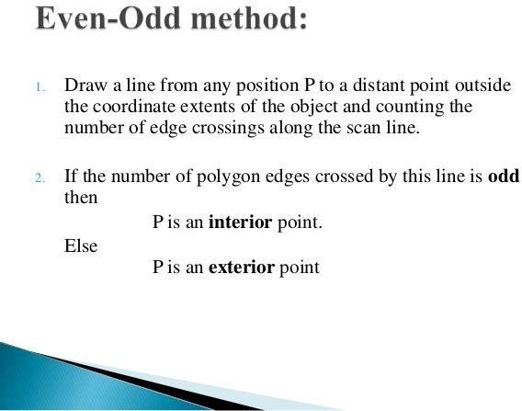
9/21/2020

Slide 39
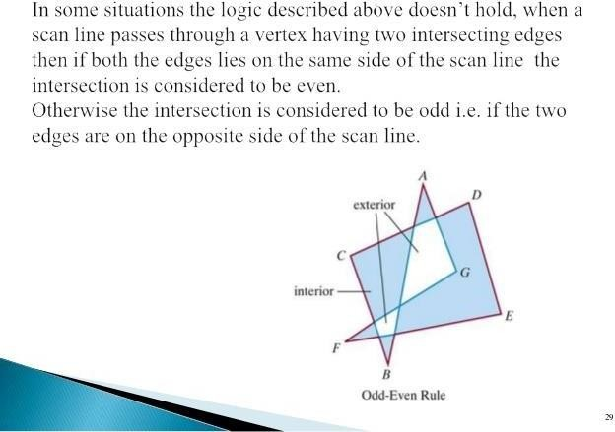
9/21/2020

Slide 40
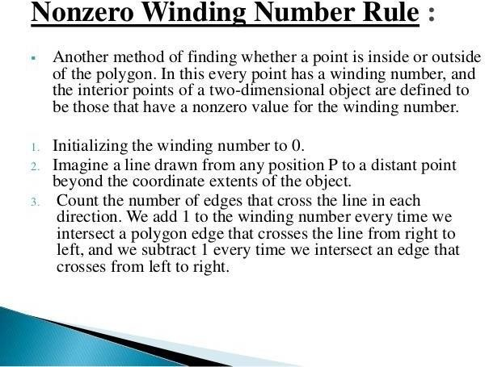
9/21/2020

Slide 41
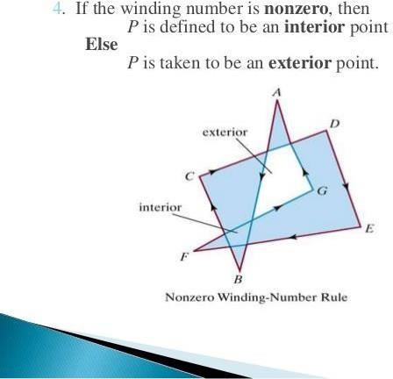
9/21/2020

Slide 42

Two dimensional transformations
Basic geometric transformations:
Translation
Rotation
Scaling

Slide 43
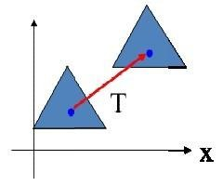
Translation
 A translation is applied to an object by repositioning it along
a straight-line path from one coordinate location to another.
 We can translate a point in 2D by adding translation distances, (tx, ty) to the original coordinate (X, Y) to move
the point to a new position (X’, Y’).

Slide 44

X’ = X +tx Y’ = Y+ ty
 The pair (tx, ty) is called the translation vector or shift vector.
 The above equations can also be represented using the column vectors.
 So, the two-dimensional translation equations in the matrix form:
P’ = P +T
 Polygons are translated by adding the translation vector to the coordinate position of each vertex and regenerating the polygon using the new set of vertex coordinates and the current attribute settings.

Slide 45
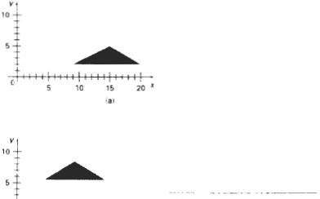

 Similar methods are used to translate curved objects. To change the position of a circle or ellipse, we translate the center coordinates and redraw the figure in the new location.

Slide 46
Problems

Slide 48
Two dimensional transformations
Basic geometric transformations:
Translation
Rotation
Scaling

Slide 49
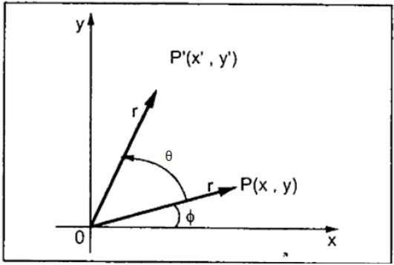
Rotation
 In rotation, we rotate the object at particular angle θ (theta) from its origin.
 To generate a rotation, we specify a rotation angle θ and the position (x_{r}, y_{r}) of the rotation point (or pivot point) about which the object is to be rotated.

Slide 50
 Suppose we want to rotate point P at the angle θ. After rotating it to a new location, we will get a new point P′(X′,Y′).
 In this figure, r is the constant distance of the point from the origin, angle φ is the original angular position of the point from the horizontal, and θ is the rotation angle.
counter- clockwise rotations about the pivot point and negative
 Positive values for the rotation angle define
values rotate objects in the clockwise direction.

Slide 51
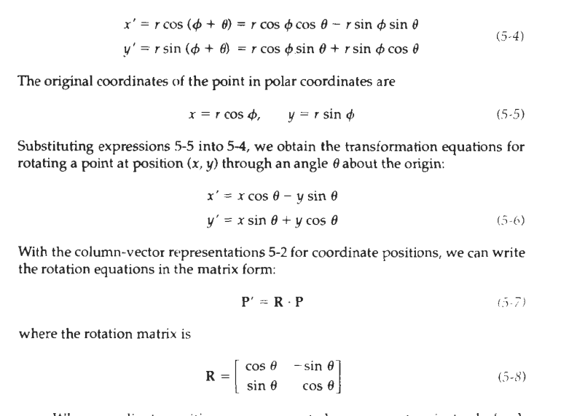

Slide 52
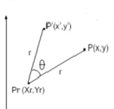
Rotation about a fixed reference point
x ' = x_{r} + (x - x_{r}) cos θ - (y – y_{r}) sin θ
y ' = y_{r} + (x - x_{r}) sin θ + (y - y_{r}) cos θ

Slide 53
 Rotations are rigid-body transformations that move objects without deformation.
 Every point on an object is rotated through the same angle.
 A straight line segment is rotated by applying the rotation equations to each of the line endpoints and redrawing the line between the new endpoint positions.
 Polygons are rotated by displacing each vertex through the specified rotation angle and regenerating the polygon using the new vertices.
 Curved lines are rotated by repositioning the defining points
and redrawing the curves.
 A circle or an ellipse can be rotated about a noncentral axis by moving the center position through the arc that subtends the specified rotation angle.
 An ellipse can be rotated about its center coordinates by rotating
the major and minor axes.

Slide 54
Two dimensional transformations
Basic geometric transformations:
Translation
Rotation
Scaling

Slide 55
Scaling
 A scaling transformation alters the size of an object.
 This operation can be carried out for polygons by multiplying the coordinate values (x, y) of each vertex by scaling factors S_{x}
and S_{y} to produce the transformed coordinates (x', y').
x' = x . S_{x} y' = y . S_{y}
 Scaling factor S_{x}, scales objects in the x direction, while S_{y} scales in the y direction.

Slide 56
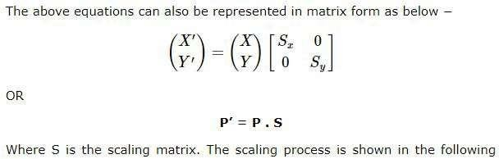
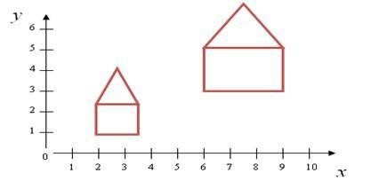

Slide 57
 If S_{x} & S_{y} >1, the size of the object will increase. Also objects move away from origin
 If S_{x} & S_{y} <1, the size of the object is reduced. Also objects
move towards origin
 If S_{x} & S_{y} =1, the size of the object will remain unchanged.
Also there will be no change in location.
 If S_{x} & S_{y} have same values, it is called uniform scaling.
 If S_{x} & S_{y} have different values, it is called differential
scaling.

Slide 58
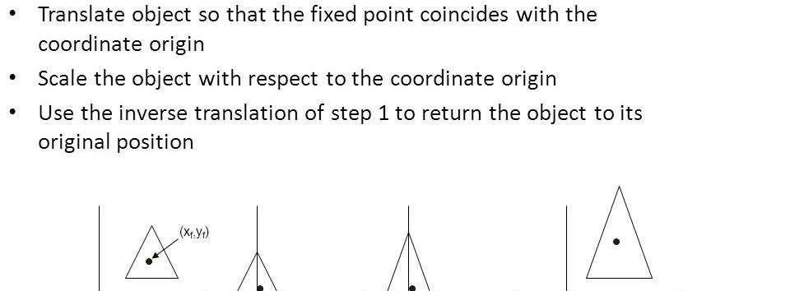
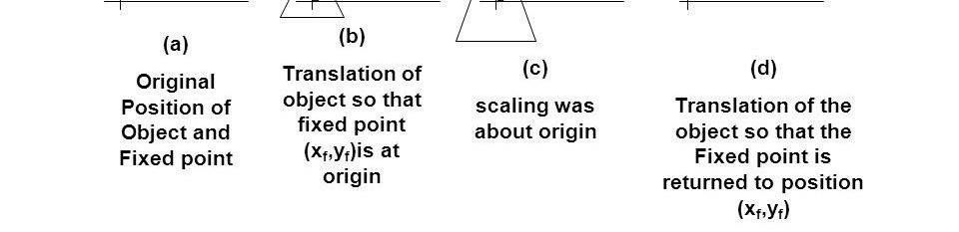
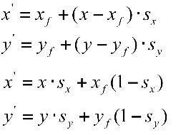
Scaling with respect to a fixed point (x_{f},y_{f})

Slide 59

Homogeneous co-ordinates
 We can represent the point by 3 numbers instead of 2 numbers, which is called Homogenous Coordinate system.
 To express any two-dimensional transformation as a matrix multiplication, we represent each Cartesian coordinate position (x, y) with the homogeneous coordinate triple (x_{h}, y_{h}, h) where
 For two-dimensional geometric transformations, we can choose the homogenous parameter h to be any nonzero value.
 A convenient choice is simply to set h = 1.
 Each two dimensional position is then represented with homogeneous coordinates (x, y, 1).

Slide 60
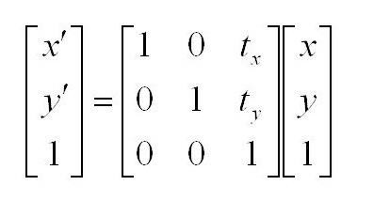
 Expressing positions in homogeneous coordinates allows us
to represent all geometric transformation equations as matrix multiplications.
 Advantages of using homogenous coordinate: We can perform all transformations using matrix/vector multiplications. This allows us to pre-multiply all the matrices together.
Translation

Slide 61
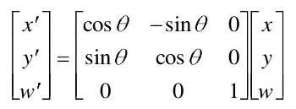
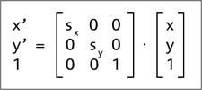
Rotation
 About the coordinate origin:
Scaling
 Scaling transformation relative to the coordinate origin:

Slide 62
COMPOSITE TRANSFORMATIONS
 We can set up a matrix for any sequence of transformations as a composite transformation matrix by calculating the matrix product of the individual transformations.
 Forming products of transformation matrices is often referred to as a concatenation, or composition, of matrices.
 For column-matrix representation of coordinate positions, we form composite transformations by multiplying matrices in order from right to left.
 That is, each successive transformation matrix premultiplies the product of the preceding transformation matrices.

Slide 63
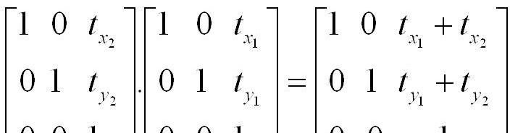
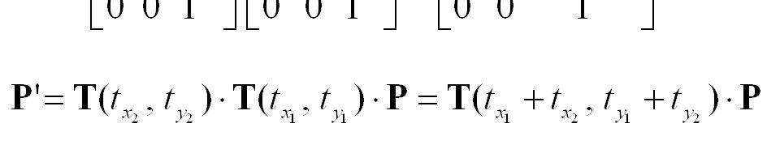
Translations
 When two successive translations are applied to a point with
translation vectors (tx1,ty1) and (tx2,ty2), then
 This demonstrates that successive translations are additive in nature.

Slide 64
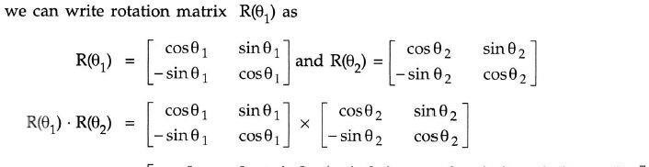
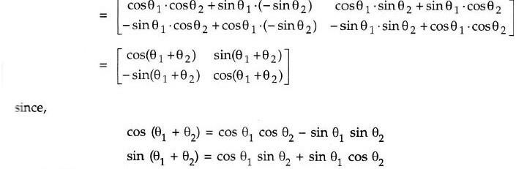
Rotations
 When two successive rotations are applied to a point ,
 This demonstrates that successive rotations are additive in nature.

Slide 65
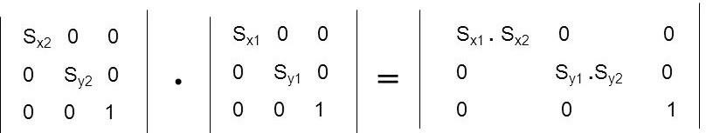
Scaling
 When two successive scaling are applied to a point, with
vectors (S_{x1}, S_{y1}) and (S_{x2}, S_{y2})
 This demonstrates that successive scalings are multiplicative in nature.

Slide 66
Rotation with respect to a fixed reference point
 We can generate rotations about any selected pivot point (xr, yr) by performing the following sequence of translate- rotate- translate operations:
1. Translate the object so that the pivot-point position is
moved to the coordinate origin.
Rotate the object about the coordinate origin.
Translate the object so that the pivot point is returned to
its original position.

Slide 67
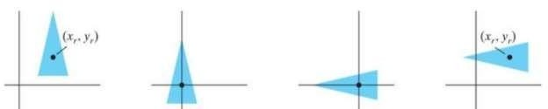
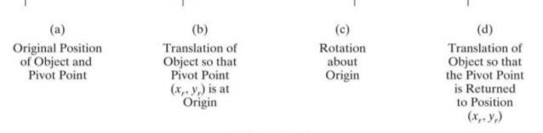

Slide 68
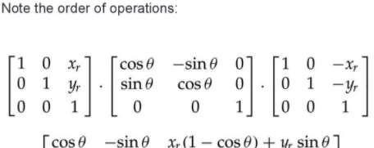
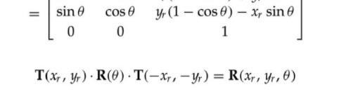

Slide 69
Scaling with respect to a
 Transfofrmixateiondseqrueencfeetorperodnucce escalpingowiitnh rtespect to a
selected fixed position (xf, yf) using a scaling function that can only scale relative to the coordinate origin.
1. Translate object so that the fixed point coincides with the
coordinate origin.
Scale the object with respect to the coordinate origin.
Use the inverse translation of step 1 to return the object to its original position.

Slide 70
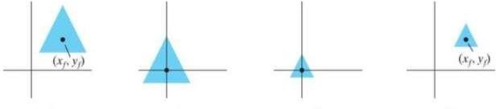


Slide 71


 Concatenating the matrices
^{for} these
three
operations
produces the required scaling matrix:

Slide 72
Matrix concatenation properties
 Matrix multiplication is associative
M₃.M₂.M₁ = (M₃.M₂).M₁ = M₃.(M₂.M₁)
 Multiplication is not commutative.
Unless the sequence of transformations are all of the same kind.
M₂.M₁ not equal to M₁.M₂ in general.
 This means that if we want to translate and rotate an object, we must be careful about the order in which the composite matrix is evaluated

Slide 73
 For some special cases, such as a sequence of transformations all of the same kind, the multiplication of transformation
matrices is commutative.
Two successive rotations could be performed in either
order and the final position would be the same.
Two successive translations or two successive scaling are commutative.
Another commutative pair of operations is rotation and
uniform scaling (S_{x}= S_{y}).

Slide 74
OTHER TRANSFORMATIONS
Reflectio
n
Shear

Slide 75
REFLECTI
 A reflection is a transformaOtionNthat produces a mirror image
of an object.
 In other words, we can say that it is a rotation operation with 180° about the reflection axis.
 In reflection transformation, the size of the object does not change.

Slide 76
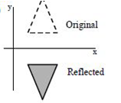
Reflection about the x axis (y = 0)
 Change the sign of y coordinate but x coordinate remains
same.
x′= x y′
= -y
 Equivalent to 180° rotation about x axis.
 In matrix form
x′ |  | 1 | 0 | 0 | x
y′ | = | 0 | -1 | 0 | y
1 |  | 0 | 0 | 1 | 1

Slide 77
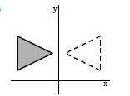
Reflection about the y axis (x = 0)
 Change the sign of x coordinate but y coordinate remains same.
x′= - x y′
= y
 Equivalent to 180° rotation about y axis.
 In matrix form
x′ |  | -1 | 0 | 0 | x
y′ | = | 0 | 1 | 0 | y
1 |  | 0 | 0 | 1 | 1

Slide 78
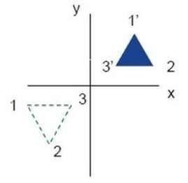
Reflection relative to the coordinate origin
 Reflection relative to an axis that is perpendicular to the xy plane and that passes through the coordinate origin.
 Change the sign of both x coordinate and y coordinate.
x′= - x
y′ = - y
 Equivalent to 180° rotation about origin.
 In matrix form
x′ |  | -1 | 0 | 0 | x
y′ | = | 0 | -1 | 0 | y
1 |  | 0 | 0 | 1 | 1

Slide 79


Reflection along an axis passing through origin and perpendicular to xy plane
We flip both the x and y coordinates of a point by reflecting relative to an axis that is perpendicular to the xy plane and that passes through the coordinate origin.
this transformation, referred to as a reflection relative to the coordinate origin, has the matrix representation:

Slide 80


Reflection about arbitrary fixed Point
This reflection is the same as a 180" rotation in the xy plane using the reflection point as the pivot point.
If we chose the reflection axis as the diagonal line y = x the reflection matrix is

Slide 81

Reflection with respect to diagonal line , line y = x
 can be obtained by performing following sequence of
transformations:
Clock wise rotation with 45°
Reflection with respect to x axis
Inverse rotation with an angle 45°
 In matrix form
x′ |  | 0 | 1 | 0 | x
y′ | = | 1 | 0 | 0 | y
1 |  | 0 | 0 | 1 | 1

Slide 82


Reflection about the diagonal y = -x
 can be obtained by performing following
transformations:
sequence of
Clockwise rotation by 45°
Reflection about the y axis
Counterclockwise rotation by 45°
 In matrix form
x′ |  | 0 | -1 | 0 | x
y′ | = | -1 | 0 | 0 | y
1 |  | 0 | 0 | 1 | 1

Slide 83
SHEAR
A transformation that distorts the shape of an object such that the transformed shape appears as if the object were composed of internal layers that had been caused to slide over each other is called shear
There are two shear transformations X-Shear and Y-Shear.
One shifts X coordinates values and other shifts Y coordinate
values.
 However, in both the cases only one coordinate changes its coordinates and other preserves its values.
 Shearing is also termed as Skewing.

Slide 84


X direction shear:
 An x-direction shear relative to the x axis is produced with the
transformation matrix
1 | sh_{x} | 0
0 | 1 | 0
0 with coordinate positions trans x′= y′=  Negative values for sh_{x} shift | 0 form x + coor | 1 ed as sh_{x} .y y dinate positions to the left.

Slide 85


 The X-Shear preserves the Y coordinate and changes are made to X coordinates, which causes the vertical lines to tilt right or left as shown in below figure.
 A unit square (a) is converted to a parallelogram (b) using the x direction shear matrix with sh_{x} = 2.

Slide 86




x-direction shears relative to other reference lines
1 | sh_{x} | - sh_{x}.y_{ref}
0 | 1 | 0
0 | 0 | 1
 An example of this shearing transformation for a shear parameter value of 1/2 relative to the line y_{ref} = -1.
with coordinate positions transformed as

Slide 87



Y-Shear
 The Y-Shear preserves the X coordinates and changes the Y
coordinates which causes the horizontal lines to transform
into lines which slopes up or down.
 The Y-Shear can be represented in matrix form as:
y' = y + sh_{y} . x x’ = x

Slide 88


 A y-direction shear relative to the line x = x_{ref} is generated with the
transformation matrix
1 | 0 | 0
sh_{y} | 1 | - sh_{y}.x_{ref}
0 | 0 | 1
which generates transformed coordinate positions

Slide 89


Example:

Slide 90



Slide 91



Slide 92



Slide 93



Slide 94



Slide 95



 Perform a 45 degree rotation of a triangle ABC having the vertices at
A(0,0), B(10,10) and C(50,20)
About the origin
About an arbitrary point P(-10,-10)
Answers:
i. Rotation about the origin
Given:
Triangle A(0,0), B(10,10) and C(50,20)
Rotation = 45°
’ =

Slide 96



Slide 97


 After rotation about arbitrary point, the new points are A(0,0), B(0,14), C(11,54)

Slide 98


 A triangle ABC with coordinates A(0,0), B(6,5), C(6,0) is scaled with scaling factors Sx=2 and Sy=3 about the vertex C(6,0). Find the transformed coordinate points.

Slide 99
3D transformations
Methods for geometric transformations and object modeling in three dimensions are
extended from two-dimensional methods by including considerations for the z coordinate.

Slide 100


Slide 101


Slide 102
Rotation
To generate a rotation transformation for an object, we require an axis of rotation (about which the object is to be rotated) and the amount of angular rotation.
A three-dimensional rotation can be specified around any line in space.
positive rotation angles produce counterclockwise rotations about a coordinate axis, if we are looking along the positive half of the axis toward the coordinate origin and negative rotation angles produce clockwise rotation

Slide 103


Rotation along Z axis

Slide 104


Rotation along x axis

Slide 105

Rotation along Y axis

Slide 106

In the special case where an object is to be rotated about an axis that is parallel to one of the coordinate axes,.
we can attain the desired rotation with the following transformation sequence

Slide 107


Slide 108


When an object is to be rotated about an axis that is not parallel to one of the coordinate axes, we need to perform some additional transformations

Slide 109


Slide 110


Slide 111


Slide 112
OTHER TRANSFORMATIONS
In addition to translation, rotation, and scaling, there are various additional transformations that are often useful in three-dimensional graphics applications.
Two of these are reflection and shear.

Slide 113
Reflections
A three-dimensional reflection can be performed relative to a selected reflection axis or with respect to a selected reflection plane.
. Reflections relative to a given axis are equivalent to 180 " rotations about that axis. Reflections with respect to a plane are equivalent to 180' rotations in four-dimensional space
The matrix representation for this reflection of points relative to the xy plane (z axis) is

Slide 114


Slide 115

SHEAR
Shearing transformations can be used to modify object shapes.
They are also useful in three-dimensional viewing for obtaining general projection

